Slide 1

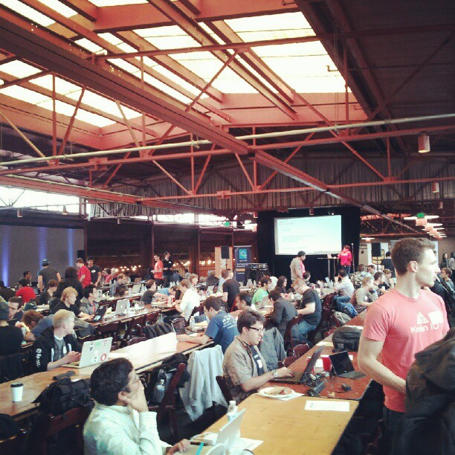
WeLoveHackathons
and we love when there are data…

Slide 2


We are Data Scientists
In God we trust all other must bring data
Emilie
The female touch
Annthomy
The Outsider
Lionel
The Warrior
Eric
The Old Man

Slide 3

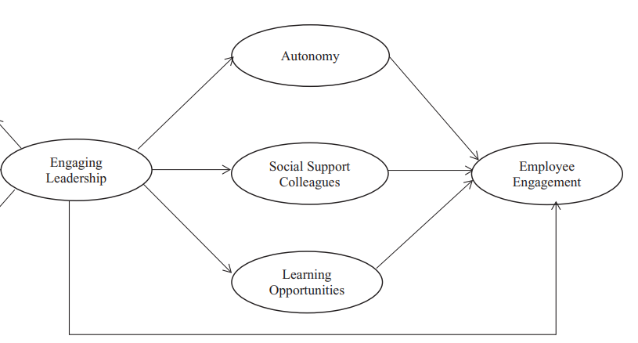
When everything starts….
What the frack is Employee Engagement (well… we may have some idea about that)
Skip Wikipedia, go directly to google scholar
Subjective notion, multidimensional concept
Feeling proud
Feeling happy
Recommend
Feeling motivated
Aligned with company goals
Beliefs leadership
Understand the role
Have access to resource or information to work
Effective of Time
Job Description
Feel heard and value
Trust colleagues and team
Fell enjoy with a group
Feel the rightplace to develop a career
Feeling challenged and excited
….

Slide 4
Get and exploit data
Overview
Must be
Real time
Gamification
All devices
Protected

Slide 5


Get and exploit data
Demo
MS Technology
Low/No code
PowerApps
Power BI

Slide 6
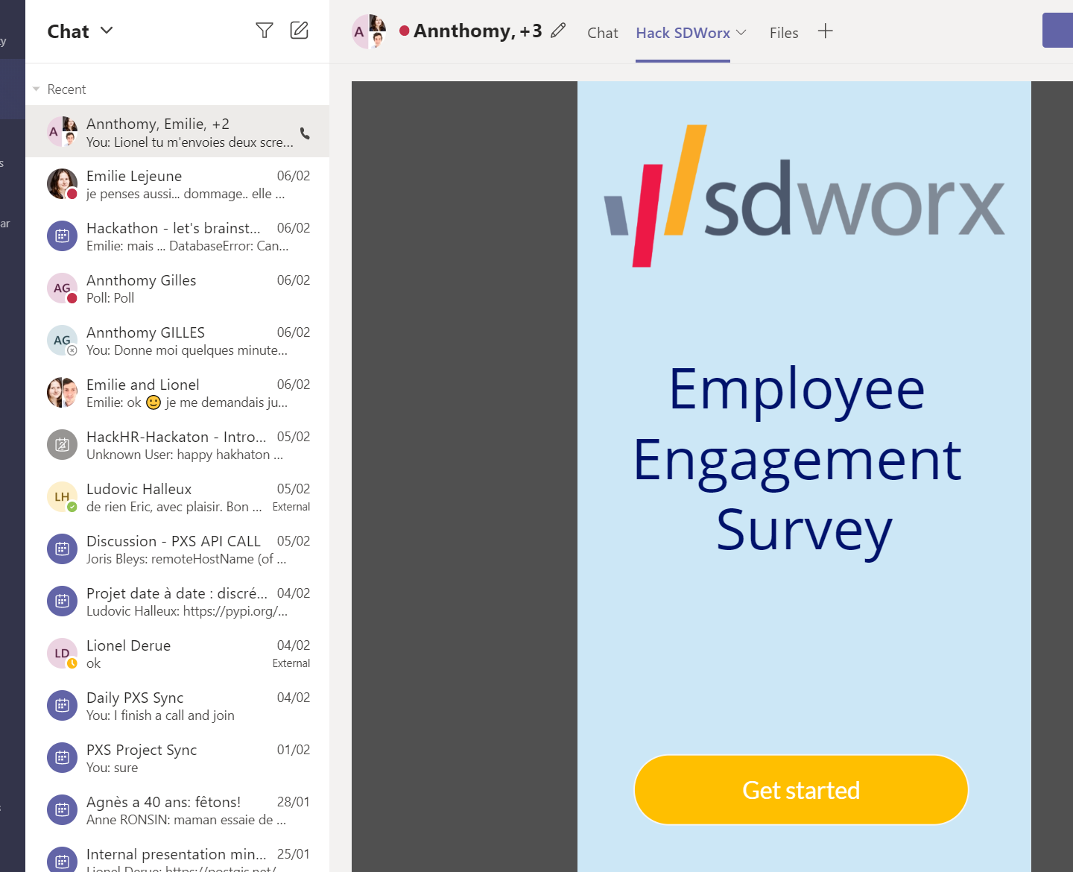
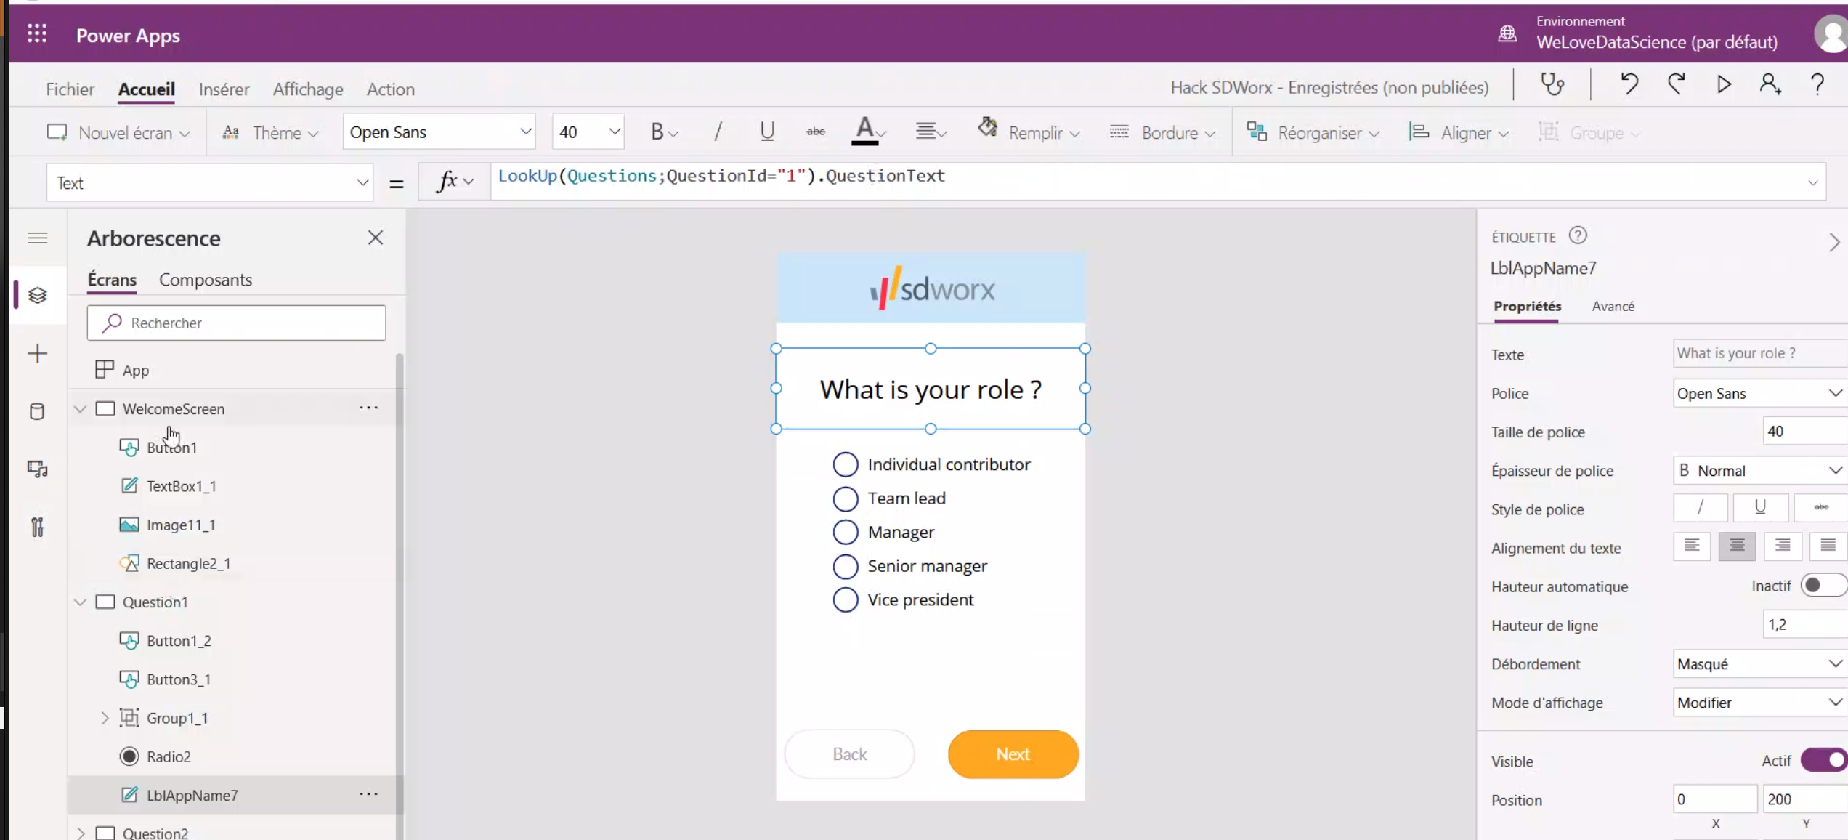
Teams integration

Slide 7
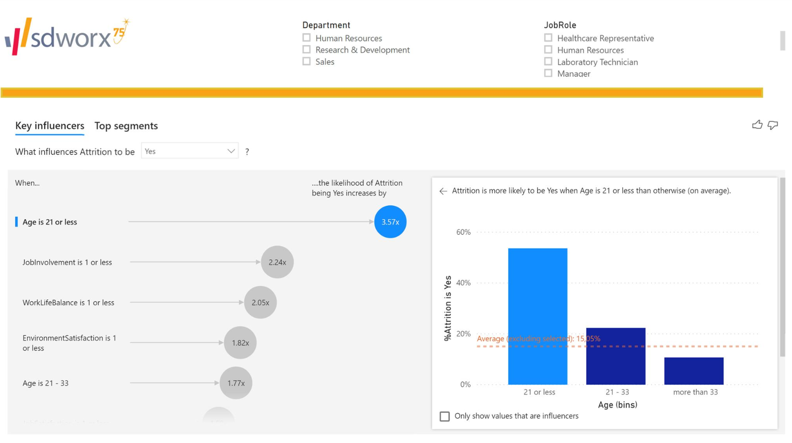
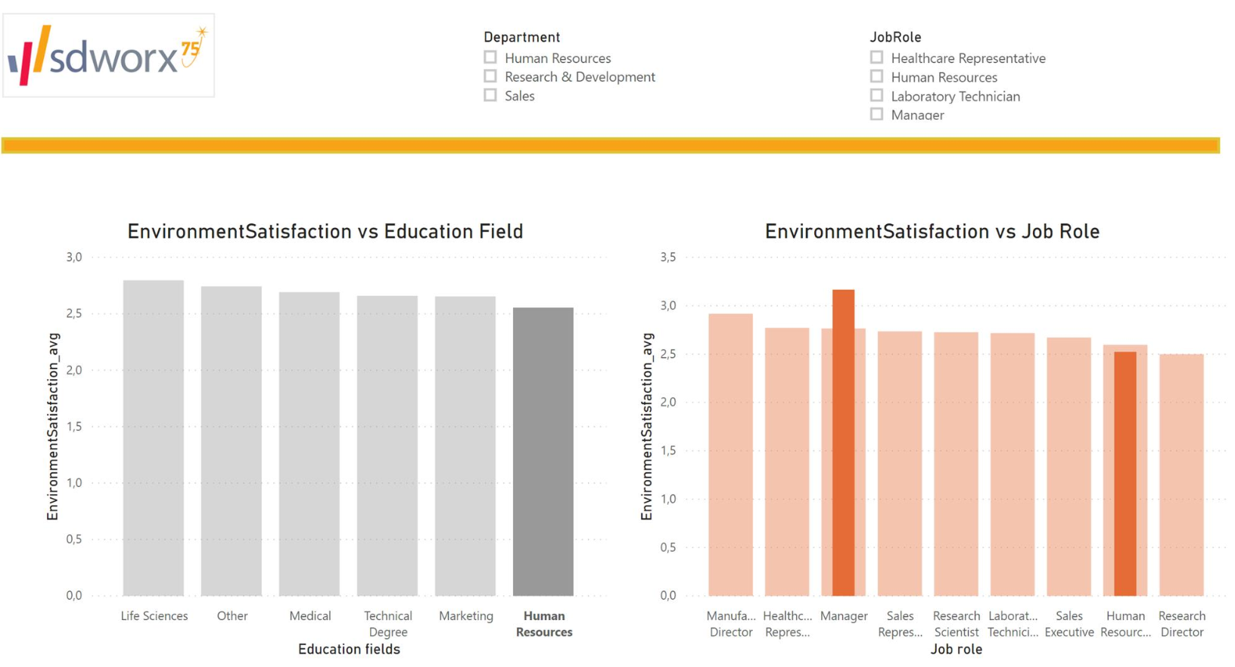
PowerBI report

Slide 8
Data is the new oil
And source of new services for SDWorx
SaaS Reports
HR Analytics
On Employee Engagement
Similar to “absenteeism” report
Aggregated data at department level, company level (GDPR compliant)
Cross with attrition data (DIMONA in Belgium)
Cross with salaries (slips)
Cross with Absenteeism
HR Analytics
Even better: cross employers sectorial benchmarks
sdworx
Monitor automatically employers EE metrics and approach them with solutions to improve EE
Objective added value through monitoring.
Start with EE data capture and add modules:
-Incentive/rewards
- Onboarding
HR Assistant (chatbot)
...
HR consultancy
Modular

Slide 9
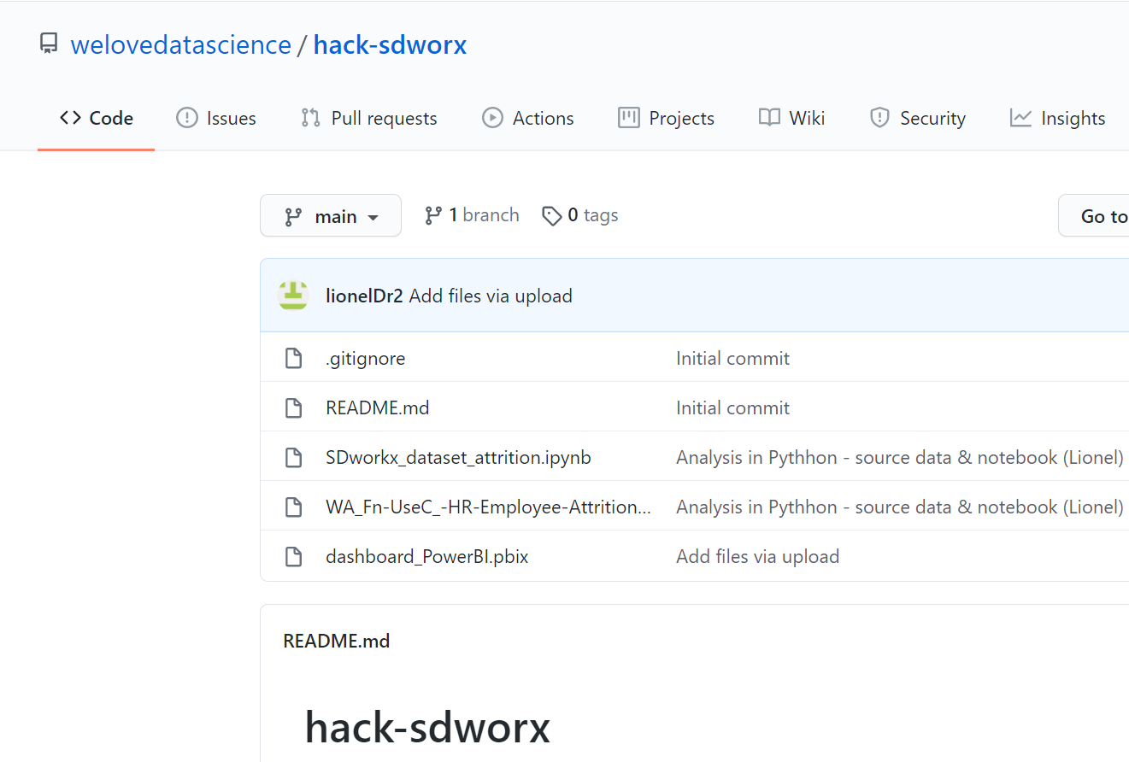
Our github
welovedatascience/hack-sdworx
Data & python analysis
WA_Fn-UseC_-HR-Employee-Attrition.csv
Python Jupyter notebook
SDworkx_dataset_attrition.ipynb
Power BI dashboard
hboard_PowerBI.pbix
SDWorx hack Teams extension
MS Power App No/Low code
Hack SDWorx.msapp
This presentation!
20210207_WeLoveHackathons.pptx

Slide 10
THANKS

